Slide 1
Q1 2022
HR Technology Sector M&A Review

Slide 2



Q1 2022
HRTECH SECTOR
Introduction
With the first quarter of 2022 closing, the new world of work has never been more apparent. After years of organisations reacting to the effects of the pandemic, the normalcy that was originally expected to return, has not, but instead has given way to an adaptive, hybrid, and technologically advanced era for businesses and how they operate.
Additionally, as unemployment rates reach record lows and job vacancies hit record highs - 1.318 million in the UK – many employers are facing the struggles associated with the labour shortage and are implementing technological capabilities to tackle this issue and improve employee retention.
As a result, organisations have shifted their focus to DEI&B, allowing employees to feel acknowledged for their contributions, in turn leading to improved engagement and retention. Secondly, with hybrid working here to stay, HR leaders need to ensure technology is implemented to maximise productivity and this way of working. Hyper-automation is becoming increasingly important, with multiple benefits being derived from its implementation. Moreover, data literacy is now more crucial than ever, to ensure HR leaders can translate and communicate the growing amount of data available.
The new world of work holds vast potential for employers to reshape the entire employee experience.
HR Technology Sector M&A Review

Slide 3

Q1 2022
Future of Work : redesigning the world of work
Incorporating Belonging into Diversity, Equity and Inclusion (DE&I)
The focus on Diversity, Equity and Inclusion (DE&I) has increased rapidly over the past few years, but it is no longer enough to just consider this, without incorporating belonging. With this new focus, organisations are increasingly prioritising DEI&B to ensure employees feel acknowledged for their work and contributions, instead of just implementing inclusivity initiatives.
This concept boosts retention, productivity, innovation and team dynamics within the workplace. Staff are also more likely to feel engaged and motivated as a result, in turn maximising opportunities for both employer and employee. According to research from Qualtrics, only 20% of employees who feel they don’t belong are engaged versus 91% of those who feel they do. Research also found that 40% of respondents with a strong sense of belonging rarely think about looking for a job elsewhere, versus 5% of respondents with a low sense of belonging.
Software providers include Wrkit Limited, acquired by BenefEx Benefit Consulting, Inc. in January 2022. Wrkit develop employee engagement platforms to support employees both in and out of work.
Pre-pandemic, 8% of remote-capable employees worked exclusively from home, with this increasing to 42% having a hybrid schedule, and 39% working entirely from home as of February 2022.
Utilising technology to elevate hybrid working
With full time migration to offices unlikely to occur ever again, and hybrid working being embraced globally, organisations are now shifting their focus to technologies that elevate this way of working, support employee-collaboration and develop smarter management solutions.
This drastic change in how we work, means steps must be taken to ensure hybrid work is productive and engaging and not just a policy or perk. Additionally, failing to offer flexible work arrangements risk an organisation's hiring, employee engagement, performance, wellbeing and retention strategies.
Technologies include Spotcues, who design and develop a platform that streamlines employee communications and workflows to keep people engaged and informed. Spotcues were acquired by UKG Inc. in February 2022. Secondly, Timesheet Mobile, develop a geofence enabled workforce management solution, enabling businesses to schedule and track their mobile employee’s projects, shift times and locations.
HR Technology Sector M&A Review

Slide 4

Q1 2022
Future of Work : redesigning the world of work
Leveraging technologies for hyper-automation
The post-pandemic world has seen the expansion of hyper-automation, allowing teams to perform quicker and more efficiently. With remote work demanding higher digital collaboration, organisations are implementing technologies to optimise the processes that HR teams engage with throughout the workday.
Hyper-automation can increase workforce competence by reducing manual work. Employee upskilling can also be improved as non-technical employees no longer need to depend on IT, meaning any business user can become an automation leader within their department. Moreover, productivity will be increased by enabling robots and people to automate the more complex and end-to-end business process from the basic process.
This orchestrated use of multiple technologies such as Artificial Intelligence (AI), Machine Learning, Robotic Process Automation (RPA) and other decision, process and task automation tools, can be utilised, allowing HR leaders to fast-track and identify, vet and automate as many business processes as possible.
Software providers include Cloudsnap, who’s technology enables seamless integration of systems to automate manual data exchange processes (acquired by Paylocity Holding Corporation in January 2022).
Data literacy is imperative today
As a result of the rapid pace of technological development, and the hybrid-working model, building a data-literate workforce is now more important now than ever.
The level of basic data literacy skills among the general HR population (excluding people analytics professionals) is one of the single greatest predictors of an organisation's people analytics maturity. Benefits such as growth, operational efficiency, and cultural transformation can all be derived from having a data literate workforce. Organisations using people analytics to support HR functions and business decisions see an 82 per cent higher-than-average profit over three years than their low-maturity counterparts.
But, with the growing amount of data across organisations - productivity metrics, survey results, sales performance and workforce costs, translating it can be a difficult task for HR teams, with 60% of organisation’s HR staff not having basic data literacy skills yet.
Acquisitions in this space include Claro, a global labour market intelligence platform, for human capital information, who were acquired by WilsonHCG in March 2022.
Companies are increasingly leveraging new technologies and data, to adjust to the new expectations of hybrid-working and improve business processes.
HR Technology Sector M&A Review

Slide 5





Q1 2022
Q1 2022
M&A Overview
In this report, we highlight 29 of the 62 M&A transactions within the HRTech sector which completed during the first quarter of 2022. Overall deal volumes have increased since the last quarter by 7% and maintained a similar volume of deals compared to the same period of 2021.
The start to 2022 has seen a continuation of this momentum which means employers must remain committed and creative in attracting and retaining top talent. Like last year, we are seeing interview processes shortened, roles decentralised and enhanced compensation and benefits programs on offer.
Notably, talent developed was hot area in M&A, with 39% of identified deals taking place in this space, followed by talent attraction and workforce management, representing 34% and 15% of the total deal volume, respectively.
Cross-border transactions accounted for 37% of the total and 99% of deals involved a strategic or PE-backed buyer. The most active regions in terms of HRTech M&A continue to be the US and Europe (mainly the UK), though the volume has declined in Asia.
Public Companies Overview
Q1 saw a decrease in average revenue multiples across our large and mid cap sample of quoted companies. This is reflective of the turbulent geopolitical market reaction to the invasion of Ukraine in late February. Central Banks have increased interest rates in this quarter to oppose growing inflationary pressure. As of 31st March, the average forward revenue multiple overall was 6.5x, going up to 7.9x for Large Cap companies.
Limeade, an immersive employee well-being company that creates healthy employee experiences, has been added to the cohort of small cap public companies we track in the HRTech space.
Revenue growth continues to be a critical driver of higher valuations. The companies exhibiting the highest expected revenue growth ReadyTech (people management software provider) and Seek (an employee marketplace). Recurring revenue as a proportion of total revenues averaged above 85%, with Small Cap companies generating as much as 94% recurring revenues.
HRTech Subsectors
Compensation and Benefits
HR software relating to the management of employee compensation and benefits administration
Performance Management
Systems to track, measure and reward employee performance
Talent Attraction
Tools to help employers recruit new staff and to help prospective employees search for jobs
Talent Development
HR software providing the means to train and develop an effective workforce
Workforce Management
HR software that facilitates ‘everyday’ HR work and the management of employees
HR Technology Sector M&A Review

Slide 6



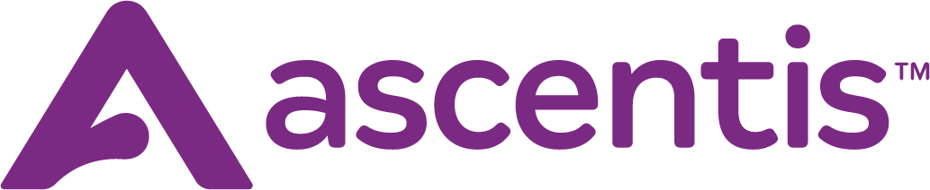
Q1 2022
DEALS SNAPSHOT
Acquisition Date: 24th February 2022
Acquisition Date: 28th February 2022
Acquisition Date: 9th March 2022
Founded in 2020 by the merger of Ultimate Software and Kronos Incorporated, one of the world’s leading HCM cloud companies, the unique Life-work Technology approach to HR, payroll, and workforce management solutions for all people helps 50,000 organisations around the globe across every industry anticipate and adapt to their employees’ needs beyond just work.
The addition of Spotcue’s Groupe.io product and its talented development team will help UKG continue to champion great experiences for all people, no matter who they are or where and how they work. The solution offers a broad array of tools that streamline employee communications and workflows to keep people engaged and informed.
Based in Puerto Rico, Interboro is a well-known and highly regarded long time reseller partner of UKG solutions. The establishment of a direct presence within the Caribbean adds nearly 70 talented team members to the UKG employee population focused solely on supporting this emerging market.
The acquisition closed in February. The opportunity to join the UKG family will not only create new opportunities for our customers to provide even better workplace experiences, but also for our own team, who will benefit from the tremendous people-driven UKG culture.
US-based Ascentis is a provider of full-suite HR and workforce management solutions that has grown from 860 customers to 4,800 customers in the past five years.
As part of the acquisition, several hundred Ascentis employees throughout the U.S. and in Montevideo, Uruguay, have joined UKG. The acquisition further solidifies UKG market strength through the addition of tenured industry expertise, with UKG currently employing 14,000 UKG employees around the world.
Ascentis are joining UKG as shared passions for innovation and unsurpassed service will evolve how HR technology supports organisations globally.
HR Technology Sector M&A Review

Slide 7

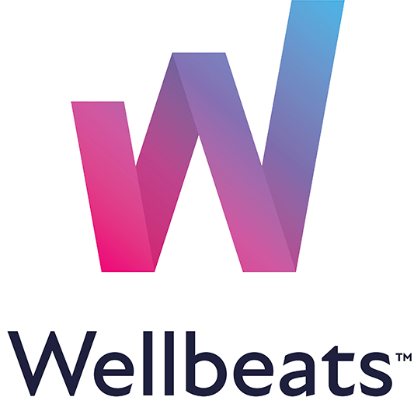


Q1 2022
DEALS SNAPSHOT
Transaction Value: $92.5m
Revenue Multiple: 4.9x
Founded in 2008, WellBeats, is the industry leader in virtual group fitness programming, delivery and engagement solutions.
With a combined 30 years of experience as respective leaders in digital health education and physical wellbeing, the acquisition supercharges LifeSpeak’s ability to meet rapidly growing demand from organisations for a comprehensive, single-vendor solution to meet mental and physical health support needs.
Many organisations have expressed a strong desire to streamline their wellbeing support to a smaller number of proven brands focusing on longer-term, preventive solutions. This makes the addition of Wellbeats highly complementary to LifeSpeak’s growing lineup of digital health offerings and allows for the further extension of the current offering to new enterprise and embedded solutions clients.
Solutions supporting the inextricable link between mental health and physical wellbeing, effectively address employee total wellbeing and may serve to improve employee productivity, engagement, and retention.
Founded in 2013, EdCast is a provider of learning experience platform (LXP) software solutions, known for its expertise and innovation in delivering personalised and contextual learning to its users. EdCast’s platform is powered by a skills engine and content marketplace via an AI-powered knowledge cloud. The company’s customers range from G2000 companies to small businesses to government organisations.
Together, Cornerstone and EdCast aim to accelerate value for customers with innovation in experiential learning, content and skill-building, and a unified and scalable talent infrastructure designed to transform learning for people and business. The deal is the next step in Cornerstone’s strategy of transforming the learning software market.
The acquisition is Cornerstone’s first planned transaction since it joined Clearlake Capital’s portfolio last year.
This is just another example of Cornerstone continuing its efforts to drive the reshaping of the learning and talent technology market. The acquisition of EdCast is an underscoring of the growth strategy of Cornerstone to be a market-leading SaaS platform provider. Cornerstone has a hybrid growth strategy combining organic growth and a new number of key acquisitions. A highlight of organic growth was its announcement of Cornerstone Xplor, a ground-breaking technological innovation to combine learning with skills-based assessments.
HR Technology Sector M&A Review

Slide 8

Q1 2022
M&A HIGHLIGHTS Q1 2022
$1.2bn
Aggregate Deal Value
Deals by Subsector
$94m
Average Deal Size
8.2x
Average Revenue Multiple
Europe
Buyers
18
Targets
19
Asia-Pacific
Buyers
5
Targets
6
North America
RoW
Buyers
38
Targets
36
Buyers
1
Targets
1
HR Technology Sector M&A Review

Slide 9

Q1 2022
SELECTED TRANSACTIONS:
TALENT ATTRACTION
DATE | BUYER | TARGET | DESCRIPTION | DEAL SIZE ($'m) | TARGET REVENUE ($'m) | REVENUE MULTIPLE (x) | TRANSACTION RATIONALE
Jan-22 | The Access Group (UK) | Vincere (UK) | A global provider of innovative recruitment software to over 20k recruitment consultants around the world. | n/a | n/a | n/a | The addition of Vincere’s recruitment operating system is the latest addition to Access Recruitment’s unique breadth of industry-leading software and significantly expands their international reach.
Jan-22 | Bullhorn (US) | Able Software (US) | Developer and operator of a platform that automates the hiring and onboarding process for employers. | n/a | n/a | n/a | The combination of Able’s candidate engagement and onboarding solutions with Bullhorn enables agencies to efficiently meet complex onboarding requirements, reduce candidate drop-out, and get candidate.
Jan-22 | Radancy (US) | firstbird (Austria) | Developer of a web-based employee referral platform for companies, recruiting agencies, and talent scouts. | n/a | n/a | n/a | The strategic acquisition combines Firstbird's referral service with Radancy’s growing suite of talent-acquisition tools.
Feb-22 | Pearson (UK) | Credly (US) | A technology company specialising in platform solutions for recruitment and employee development. | 200.0 | 13.3 | 15.0 | The acquisition of Credly, in which Pearson has a nearly 20% stake, will expand the company’s presence in the workforce skills sector, adding a robust credentialing service to its workforce analysis, learning and assessment capabilities.
Feb-22 | Alef Edge (US) | CareerGig (US) | CareerGig is a technology platform and ecosystem that matches freelance and contract workers to top employers. | n/a | n/a | n/a | The acquisition will allow Alef to fast track the adoption of the edge by arming mobile developers with its enterprise grade suite of APIs to build custom private 5G mobile networks and applications.
HR Technology Sector M&A Review

Slide 10
Q1 2022
SELECTED TRANSACTIONS:
TALENT ATTRACTION
DATE | BUYER | TARGET | DESCRIPTION | DEAL SIZE ($'m) | TARGET REVENUE ($'m) | REVENUE MULTIPLE (x) | TRANSACTION RATIONALE
Feb-22 | Poolia AB (Sweden) | Roi Rekrytering (Sweden) | Roi Rekrytering is a SaaS tool that enables small and midsize companies to facilitate the management of their own recruiting. | n/a | n/a | n/a | With Poolia’s large sales force, there are very good opportunities to shift up sales of Roi Rekrytering’s recruitment platform Workspace Recruit.
Feb-22 | Equifax (US) | Efficient Hire (US) | Efficient Hire is an employee on-boarding for staffing firms and PEOs that automates electronic solutions for dynamic and cost-effective forms. | n/a | n/a | n/a | Efficient Hire aligns with Equifax's strategy to reinvest their strong performance in strategic and bolt-on acquisitions that strengthen their business and position them for diversified growth.
Feb-22 | SmartRecruiters (US) | Attrax (UK) | An industry-leading provider of career site software that lets companies build engaging, personalised career sites. | n/a | n/a | n/a | The acquisition will result in an integrated offering, SmartRecruiters Attrax, designed to help customers build data-powered, curated career sites that enhance the candidate experience and improve hiring outcomes.
Feb-22 | Checkr (US) | ModoHR (South Korea) | Provider of scalable and compliant solutions to conduct accurate background checks through their leading ScreeningCanada platform. | n/a | n/a | n/a | ModoHR will significantly enhance Checkr's offering, bringing the ScreeningCanada technology and expertise to North American organisations. Specifically, the acquisition will allow Checkr clients greater access to Canadian background check data.
Mar-22 | Access Group (UK) | FastTrack (Australia) | Provider of Windows-based applications for the recruitment industry in Australia. | n/a | n/a | n/a | Working with the Access’s 1,000-strong APAC team and its wider global employee base, FastTrack will support Access Recruitment’s delivery of customer solutions.
Mar-22 | PlayToWork (Netherlands) | Bijbanaan (Netherlands) | An online portal that recruits qualified candidates for various companies. | n/a | n/a | n/a | The strength of both PlaytoWork and Bijbanaan is linking young people to jobs based on their skills and ambitions. In the philosophy of both companies, talents and dreams, even more than diplomas, are the key to finding a suitable job.
HR Technology Sector M&A Review

Slide 11
Q1 2022
SELECTED TRANSACTIONS:
TALENT ATTRACTION
DATE | BUYER | TARGET | DESCRIPTION | DEAL SIZE ($'m) | TARGET REVENUE ($'m) | REVENUE MULTIPLE (x) | TRANSACTION RATIONALE
Mar-22 | ReadyTech (Australia) | PhoenixHRIS (Australia) | Offerer of a cloud-based application for online recruitment management, including job requisition, video screening, candidate testing, verification, and onboarding. | 2.5 | 0.9 | 2.7 | The acquisition bolsters the workforce solutions all-in-one capability and product-market fit in the stand-up economy, which is expected will create strong cross sell/upsell opportunities in the existing customer base, as well increasing the attractiveness of the ReadyTech all-in-one platform to new customers.
Mar-22 | Icims (US) | Candidate.ID (Scotland) | Provider of commercial digital skills through a subscription-based, proprietary digital platform. | n/a | n/a | n/a | The combination of both companies creates a market leading player in the AI-based search and match technology space.
HR Technology Sector M&A Review

Slide 12

Q1 2022
SELECTED TRANSACTIONS:
TALENT DEVELOPMENT
DATE | BUYER | TARGET | DESCRIPTION | DEAL SIZE ($'m) | TARGET REVENUE ($'m) | REVENUE MULTIPLE (x) | TRANSACTION RATIONALE
Jan-22 | Learning Pool (UK) | True Office Learning (US) | The creator of award-winning adaptive eLearning and behavioral intelligence technology that measurably improves performance in organisations around the world. | n/a | n/a | n/a | Learning Pool and True Office Learning will be able to demonstrate the advantages of delivering compliance learning through an LXP to meet critical business needs today, whilst also preparing the workforce for tomorrow.
Jan-22 | 360Learning (US) | Looop Online (UK) | Provider of a learning management system platform for employees. Its platform helps users to guide and support people using automation and data insights. | 20.0 | n/a | n/a | As part of the acquisition, 360Learning and Looop will usher in a new era of collaborative learning, focused on L&D automation and leadership, to help customers succeed in the face of shifts towards remote work, employee turnover, and the looming skills shortages.
Jan-22 | Benefex Benefit Consulting (US) | Wrkit (Ireland) | Developer of employee engagement platforms that deliver learning, wellbeing, recognition, and lifestyle savings options that combine to support employees both in and out of work. | n/a | n/a | n/a | Bringing the Wrkit team and product into BenefEx’s business further supports their mission to help every employee have an exceptional experience, every day. By adding an employee discount offering, a behavioural-science-led wellbeing platform and new communications tools to the OneHub product suite, they can help every customer solve more of their employee engagement challenges.
Feb-22 | Alithya Group (Canada) | Vitalyst (US) | Vitalyst is a global provider of learning solutions driving digital adoption and proficiency on over 350 standard, advanced and proprietary applications. | 50.2 | 26.4 | 1.9 | The Vitalyst experts will be able to accelerate growth by tapping into Alithya Group’s other global clients and add to their offerings for a variety of the business applications they support.
Feb-22 | Lifespeak (Canada) | Wellbeats (US) | Minnesota-based market-leading provider of an on-demand, physical wellbeing platform, serves a diverse client base of 400+ U.S. and international enterprise clients. | 92.5 | 19.0 | 4.9 | The acquisition of Wellbeats is highly complementary to LifeSpeak's growing portfolio of digital wellbeing solutions and allows them to further enhance their offerings for existing and new enterprise and embedded solutions clients.
HR Technology Sector M&A Review

Slide 13
Q1 2022
SELECTED TRANSACTIONS:
TALENT DEVELOPMENT
DATE | BUYER | TARGET | DESCRIPTION | DEAL SIZE ($'m) | TARGET REVENUE ($'m) | REVENUE MULTIPLE (x) | TRANSACTION RATIONALE
Feb-22 | Perceptyx (US) | Cultivate (US) | Cultivate is a digital leadership platform that leverages AI to scale coaching across the enterprise, enabling stronger workplace relationships and empowering people leaders. | n/a | n/a | n/a | The deal will pair Perceptyx’s active listening and feedback platform with Cultivate’s best-in-class passive listening and digital coaching product, creating a powerful solution that closes the gap between signal and action in the employee experience.
Feb-22 | PSI Services (US) | Solvably & Digital Skills Lab (US) | Operator of a platform that offers employee engagement activities. | n/a | n/a | n/a | PSI Talent Management's psychological expertise paired with Solvably's inspiring technology introduces the learning and development market to a novel and engaging way of driving behaviour change.
Feb-22 | UKG (US) | Spotcues (US) | Designer and developer of a platform that streamline employee communications and workflows to keep people engaged and informed. | n/a | n/a | n/a | The addition of Spotcues’ Groupe.io product and its development team will help UKG continue to champion great experiences for all people, no matter who they are or where and how they work.
Mar-21 | Cornerstone (US) | EdCast (US) | Developer of AI-powered cloud-based knowledge talent experience platforms designed to enable end-to-end employee journeys spanning learning, skilling, and career mobility. | n/a | n/a | n/a | The combination of Cornerstone and EdCast is poised to accelerate the pace of innovation in the market. Together they can transform the way customers develop the skills of the future, retain and grow their people, improve agility, and unify and scale learning and talent infrastructure in lockstep with business needs.
HR Technology Sector M&A Review

Slide 14

Q1 2022
SELECTED TRANSACTIONS:
workforce management solutions
DATE | BUYER | TARGET | DESCRIPTION | DEAL SIZE ($'m) | TARGET REVENUE ($'m) | REVENUE MULTIPLE (x) | TRANSACTION RATIONALE
Jan-22 | Paylocity (US) | Cloudsnap (US) | Cloudsnap's technology enables seamless integration of systems to automate manual data exchange processes, creating a modern user experience. | n/a | n/a | n/a | Cloudsnap technology will enable Paylocity to deliver modern integrations and seamless data sharing between critical systems more efficiently and effectively, while helping to unify and automate business processes across HR, Finance, Benefits, and other systems.
Feb-22 | Visma (Norway) | Medinet (Sweden) | Medinet's range of workforce management services aims to optimise and streamline the staffing process through health scheduling and integration with leading payroll systems. | n/a | n/a | n/a | The acquisition will strengthen Visma's WFM offering for healthcare organisations in Sweden.
Feb-22 | UKG (US) | Interboro (Puerto Rico) | Engages in the distribution of automated timekeeping products. | n/a | n/a | n/a | UKG now provides direct sales, services, and customer support for the Caribbean market through the acquisition of Interboro Systems Corporation.
Mar-22 | UKG (US) | Ascentis (US) | Developer of a (HR) management, online payroll, and human capital management solutions in the United States and Canada. | n/a | n/a | n/a | The acquisition further solidifies UKG market strength through the addition of tenured industry expertise, with UKG currently employing 14,000 UKG employees around the world.
HR Technology Sector M&A Review

Slide 15

Q1 2022
SELECTED TRANSACTIONS:
COMPENSATION AND BENEFITS
DATE | BUYER | TARGET | DESCRIPTION | DEAL SIZE ($'m) | TARGET REVENUE ($'m) | REVENUE MULTIPLE (x) | TRANSACTION RATIONALE
Feb-22 | Zalaris HR Services (Norway) | vyble (Germany) | A German provider of cloud-based payroll & HR management (SaaS) for the SME market serving approximately 600 customers with 14k employees. | 1.2 | 1.2 | 1.0 | Zalaris will, together with the employees of vyble, continue the development of the vyble cloud platform and with the ambition to become a significant player in the growing market - for fully digitised payroll and HR solutions for SMEs in Germany.
Feb-22 | Employment Hero (UK) | KeyPay (US) | Developer of a cloud based payroll and workforce management platform. | n/a | n/a | n/a | This acquisition helps Employment Hero deliver a suite of total employment management solutions - Talent Solutions, Core HR; Payroll and eBenefits.
HR Technology Sector M&A Review

Slide 16

Q1 2022
SELECTED TRANSACTIONS:
performance management
DATE | BUYER | TARGET | DESCRIPTION | DEAL SIZE ($'m) | TARGET REVENUE ($'m) | REVENUE MULTIPLE (x) | TRANSACTION RATIONALE
Mar-22 | WilsonHCG (US) | Claro (US) | Claro is a global labour market intelligence platform, like Bloomberg for human capital information. | n/a | n/a | n/a | This acquisition enables WilsonHCG to provide even more comprehensive real-time talent insights to help organisations attract and retain talent.
HR Technology Sector M&A Review

Slide 17
Q1 2022
PUBLIC COMPS HIGHLIGHTS Q1 2022
6.5x
Avg. EV/Revenue CY2021E
Historic Revenue Multiples
Large Cap
7.9x | 18% | 83.7%
Avg. EV/Revenue | Avg. Revenue Growth | % Recurring Revenue
Mid Cap
3.1x | 16% | 89.3%
Avg. EV/Revenue | Avg. Revenue Growth | % Recurring Revenue
Small Cap
1.1x | 11% | 94.0%
Avg. EV/Revenue | Avg. Revenue Growth | % Recurring Revenue
16%
Avg. Revenue Growth CY2020
86%
% Recurring Revenue
Revenue Growth Distribution
EBITDA Margin Distribution
Number of Companies
Number of Companies
HR Technology Sector M&A Review

Slide 18
Q1 2022
GOLDENHILL HRTECH INDEX
HR Technology Sector M&A Review

Slide 19
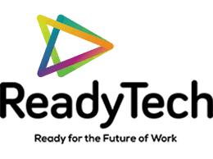



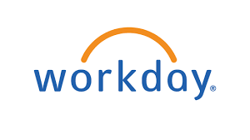









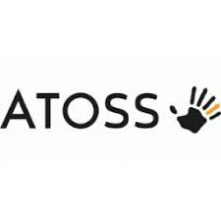


Q1 2022
PERFORMANCE QUADRANTS
The Rule of 40 is a recognised measure of health for SaaS companies, which states that Revenue Growth % and EBITDA Margin (profitability) should ideally add up to
roughly 40%.
HIGHER MARGINS
HIGHER
GROWTH
HR Technology Sector M&A Review

Slide 20





Q1 2022
REVENUE GROWTH AS A VALUE DRIVER
Revenue growth continues to be one of the most important drivers for higher valuations. The companies exhibiting the highest expected revenue growth this year are Ready Tech (people management software provider), Seek (an employee marketplace and Paylocity (cloud-based payroll and human capital management software).
HR Technology Sector M&A Review

Slide 21
Q1 2022
SECTOR VALUATION METRICS
(1) Excludes treasury shares; (2) Net financial debt minus marketable securities and collaterals; (3) Recurring revenues (renewing licences, maintenance, subscriptions, SaaS etc.) where reported for last full year; (4) NM - Not meaningful and NA - Not available
HR Technology Sector M&A Review

Slide 22

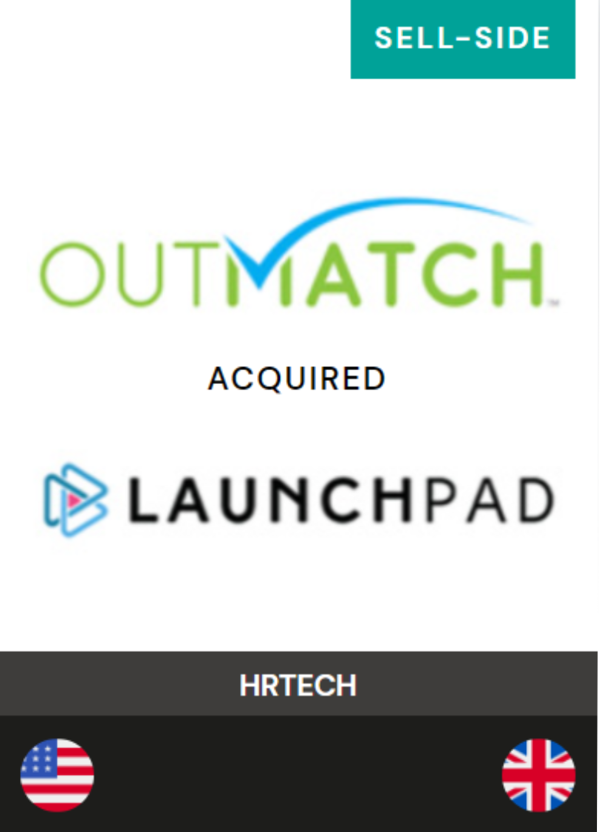
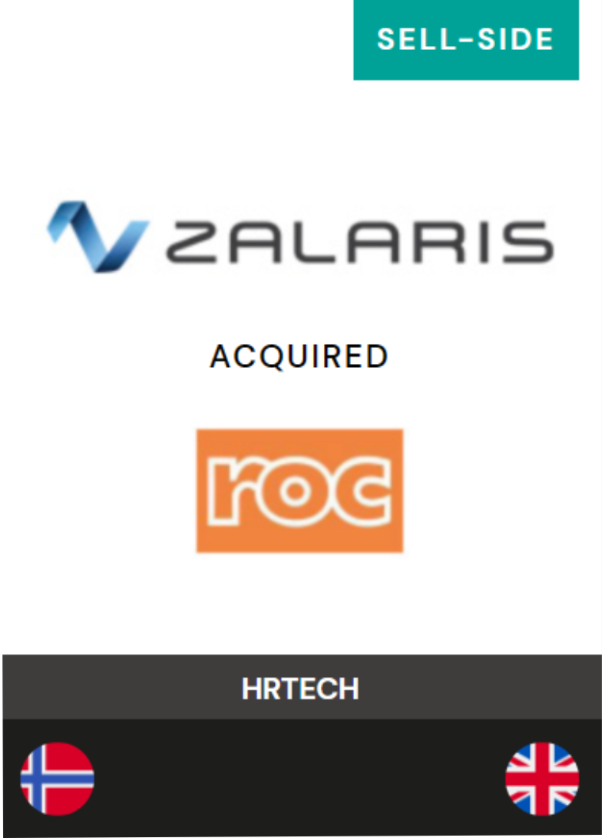
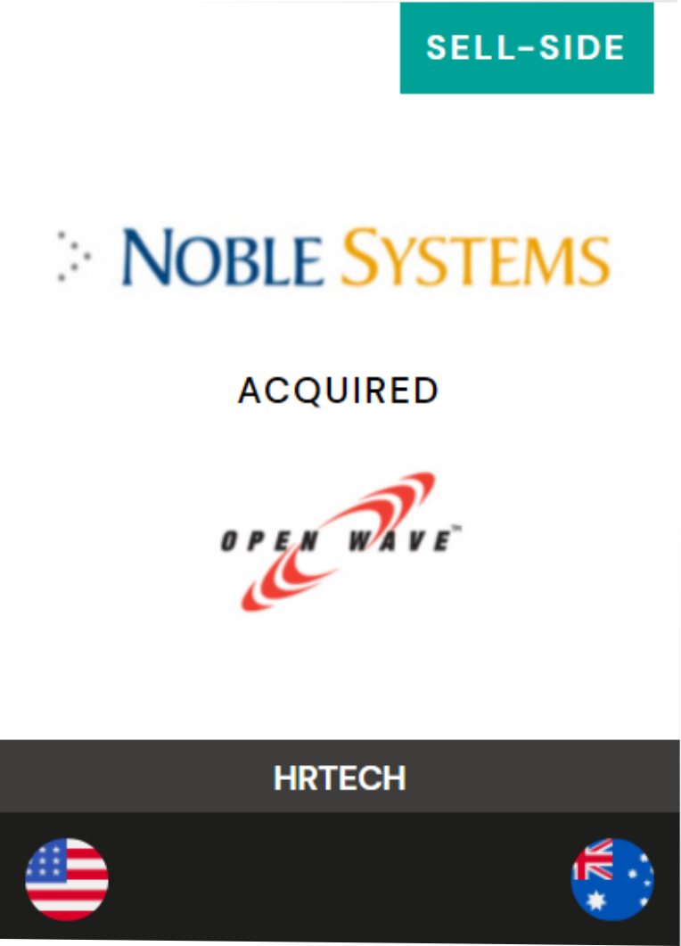




Quick Facts
Sector experts focused on providing advisory services to sellers and buyers in M&A projects across the globe.
Deep domain expertise across software, services and data intensive sectors, with a focus on FinTech, HRTech and Workforce Solutions.
Our Partners have advised on 100+ transactions with values ranging from $15 million to over $100 million; the majority (70%) of our engagements result in cross-border transactions.
International presence with offices in London, Milan, San Diego, Luxembourg, and Buenos Aires.
Proven track record of successful long-term advisory relationships positioning clients for premium transactions using current insights into the relevant strategic acquirers.
Philip Albright
London
William Berrington
London
Kevin O’Neill
San Diego
Carlos Ratto
Milan

